Slide 1
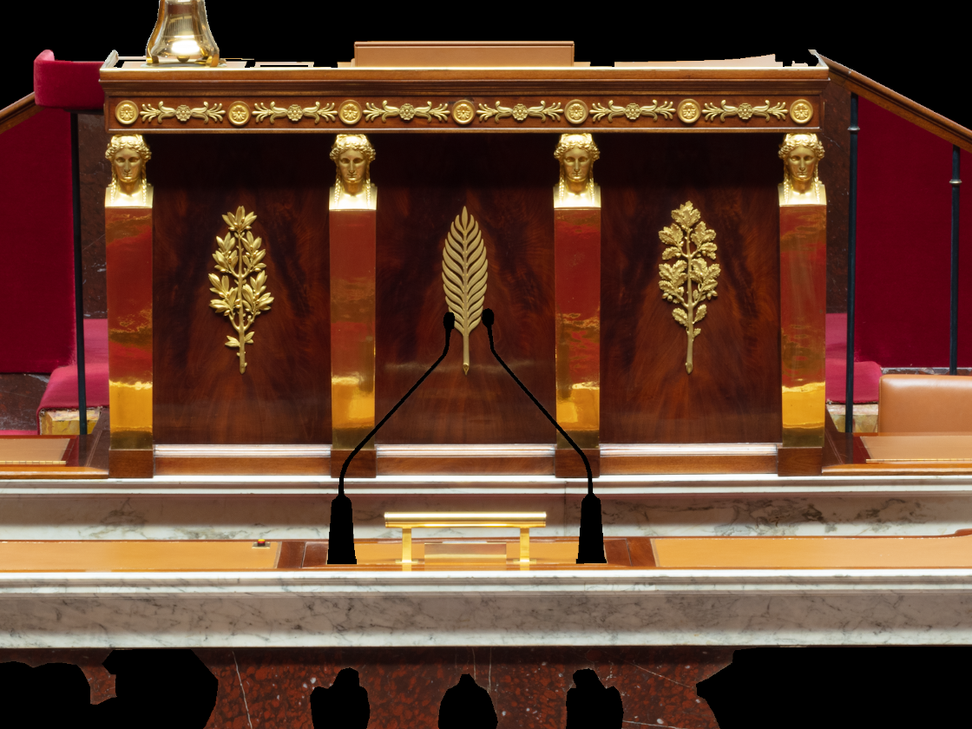
Crop_image_pix2pix.py
Program design to crop an image in sub-images.
With this function we need to specify the position x and y where the input image will be crop and the size of the croped images.
We want to crop the input image on the left in 9 sub-images of size 480x352

Slide 2
Crop_image_pix2pix.py
x = [ 0, 330, 640 ]
480
352
y = [ 0, 250, 488 ]

Slide 3

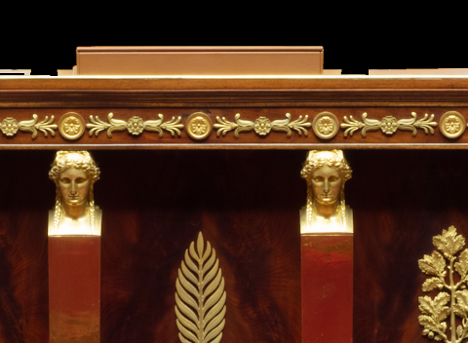

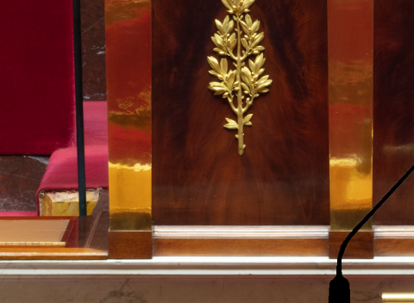

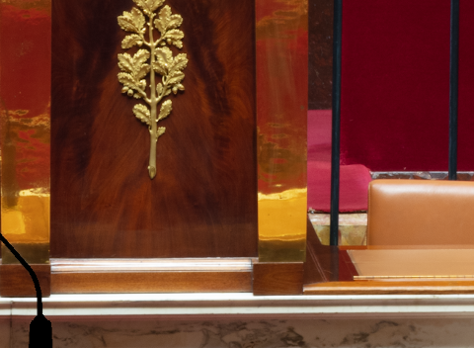
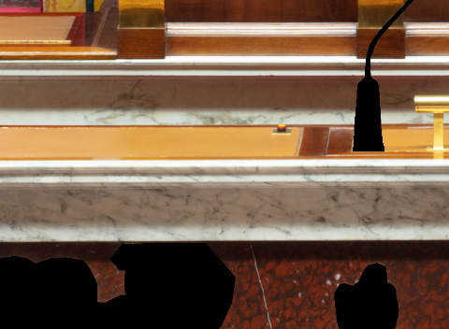
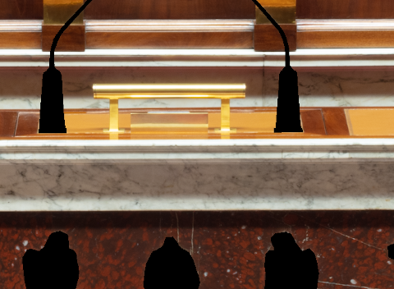
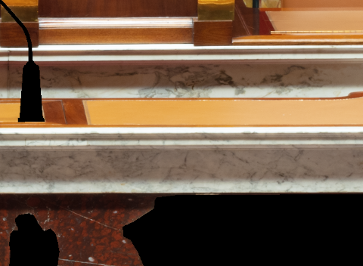
Crop_image_pix2pix.py
000001.Png 000002.png 000003.png
000006.Png 000005.png 000004.png
000007.Png 000008.png 000009.png

Slide 4




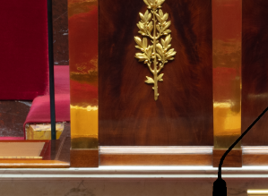





Reconstruct_image_pix2pix.py
Program design to reconstuct images initialy crop with crop_image_pix2pix.py.
With this function we need to specify :
The position x = [0,330,640] and y = [0,250,488] where the initial input image have been croped.
The size of the input images (480x352 here)
Number of images to reconstruct and number of sub-images to use to reconstruct one image
The pixel band width where to apply the smoothing

